Slide 1
Microsoft Office Word
CSE 1108
Introduction to Computer Systems

Slide 2
Create new documents from scratch
Search with Microsoft Office Word
Right Click ⇒ New ⇒ Microsoft Office Word Document

Slide 3
Save and open previous documents.
Office Button (top left corner) ⇒ Save
Office Button (top left corner) ⇒ Open

Slide 4
Creating PDF and Other Format files from Word Doc.
Office Button (top left corner) ⇒ Save As ⇒ Select Format

Slide 5
Shortcuts
Copy : ctrl + c
Cut: ctrl + x
Paste: ctrl + v
Bold: ctrl + b
Italic: ctrl + I
Underlined: ctrl + u
Save: ctrl + s
Save as: f12
Open: ctrl + o
Close: ctrl + f4 or ctrl + w
Undo: ctrl + z

Slide 6


Font family, size and style

Slide 7




Bold, italic, underlined, strikethrough.
Bold: ctrl+b or
Italic: ctrl+I or
Underlined: ctrl+u or
Strikethrough:

Slide 8
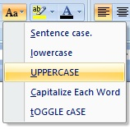
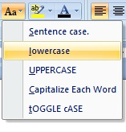
All caps, all small, superscript, subscript.
All caps:
All small:

Slide 9


Superscript: ctrl+shift++ or
Subscript: ctrl+= or

Slide 10



Text alignment, indentation and line spacing.
Text alignment:
Indentation:
Line spacing:

Slide 11

Bullets and numbers.

Slide 12


Text color, highlight, and word art.
Text color:
Highlight:

Slide 13
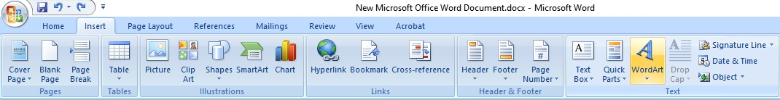
Word art

Slide 14
Find and replace.
Ctrl+F

Slide 15
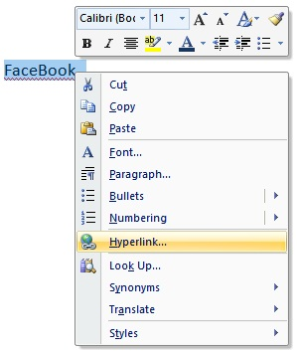
Hyperlink.

Slide 16


Equation and symbols
Equation: Alt+= or
Symbols:

Slide 17
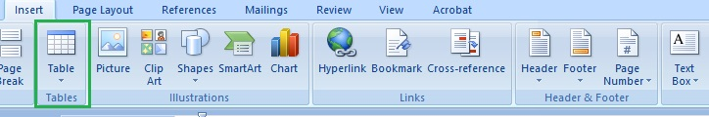
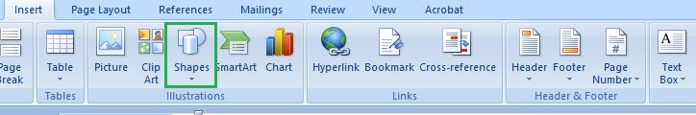
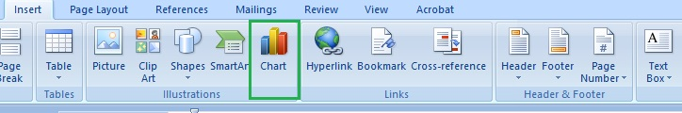
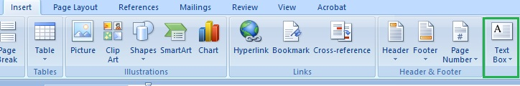
Table, charts, shapes, and text box.

Slide 18
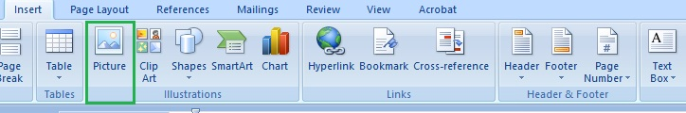
Image insertion and position

Slide 19
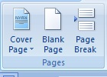
Cover page, blank page, page break.

Slide 20

Page header, footer and page numbers.

Slide 21
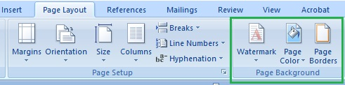
Watermark, page color, page border.

Slide 22
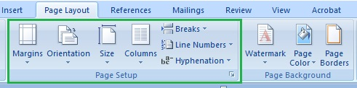
Page setup: margin, ruler, size, orientation, columns and line numbers

Slide 23
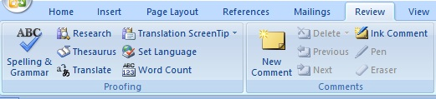
Review, checking, and word count.

Slide 24
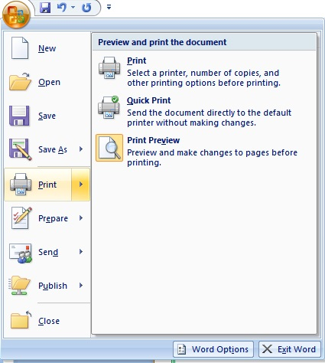
Viewing modes and print options.

Slide 25
Online
Create a flowchart for defining odd or even number.
Given an image file like the following replicate the image using MS Word.

Slide 26
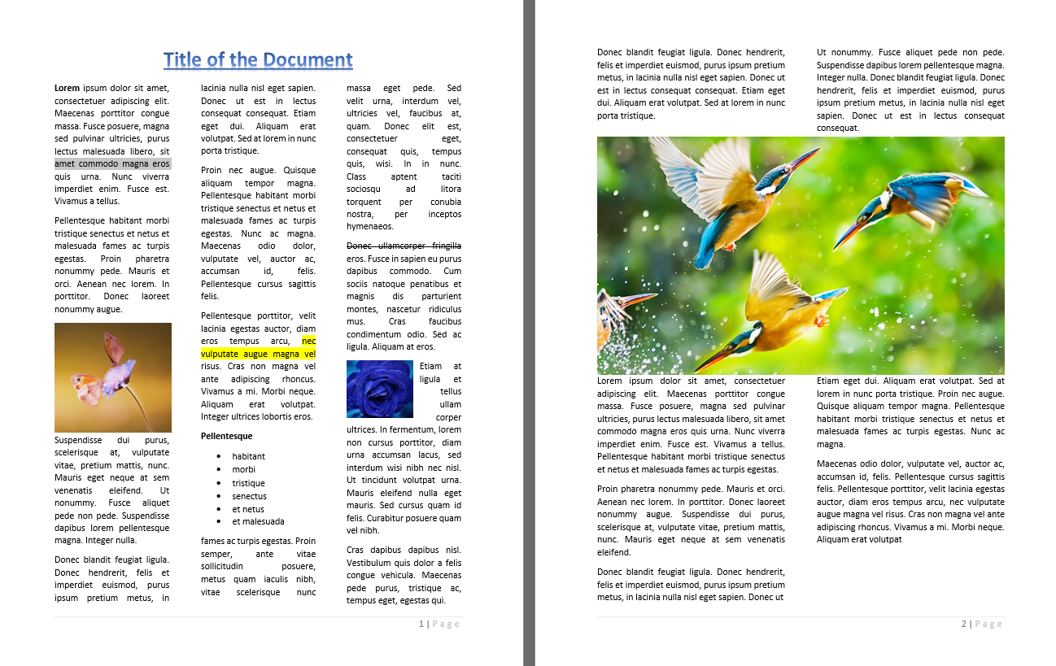
Given an image file like the following replicate the image using MS Word.

Slide 27
ASSIGNMENT
Prepare a job openings advertisement for a company with some specifications.
Make your class routine.

Slide 28
?

